Slide 1
Conceptualizing the Student Voice through Communication Pathways, an NFETL Initiative

Slide 2
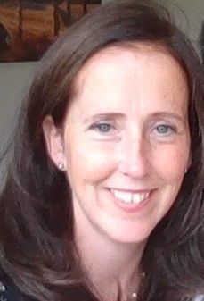
Maureen Haran, PhD(c) Department of Social Science, ATU Sligo Lecturer, UDL Institute Project Lead

Slide 3
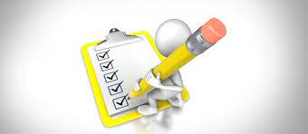
1. NFETL Initiative Context 2. What did we seek to do? Conceptualize the Student Voice. 3. How did we do it? National Badge Roll Out, Questionnaires, Focus Groups 4. What did we learn? Common themes emerging, Findings 5. Next Steps Answering the ‘So What?’
Presentation Contents

Slide 4
WHAT DID WE SEEK TO DO?

Slide 5
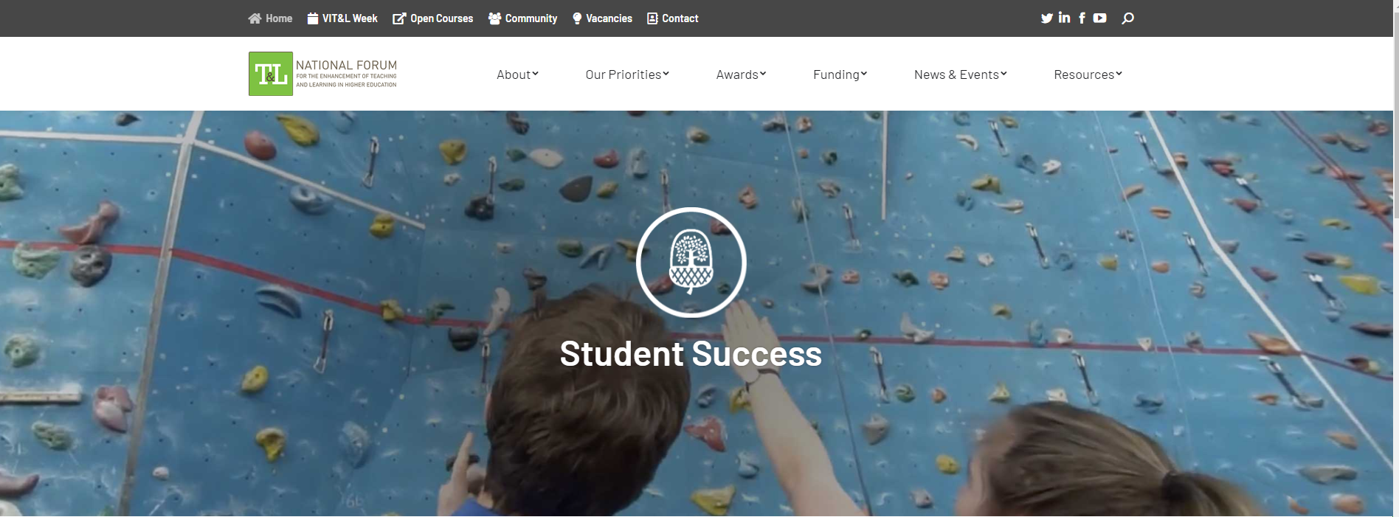
National Forum for Enhancement in Teaching & Learning
NFETL Initiative Context

Slide 6
Key Deliverables
Best Inclusive Practice Toolkit publication (Digital Ed)
Capturing the student voice through communication pathways
Student led conference conceptualizing UDL with the student voice
NFETL: Teaching and Learning Initiatives 5.1. T&L Initiative Type 001 Focus on Supporting and Highlighting the Value of Teaching and Learning Enhancement within Higher Education Institutions.

Slide 7
Switching the Focus…

Slide 8
HOW DID WE DO IT?

Slide 10
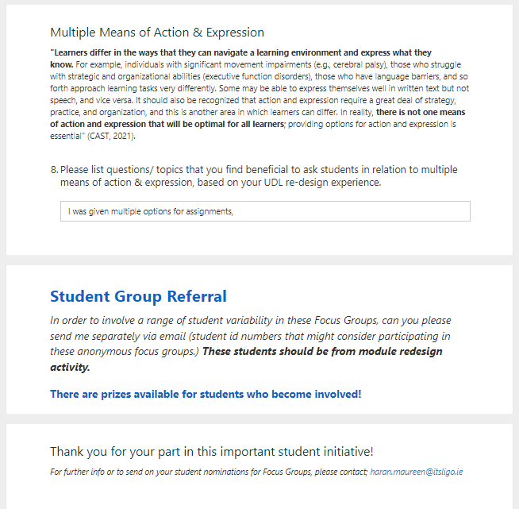
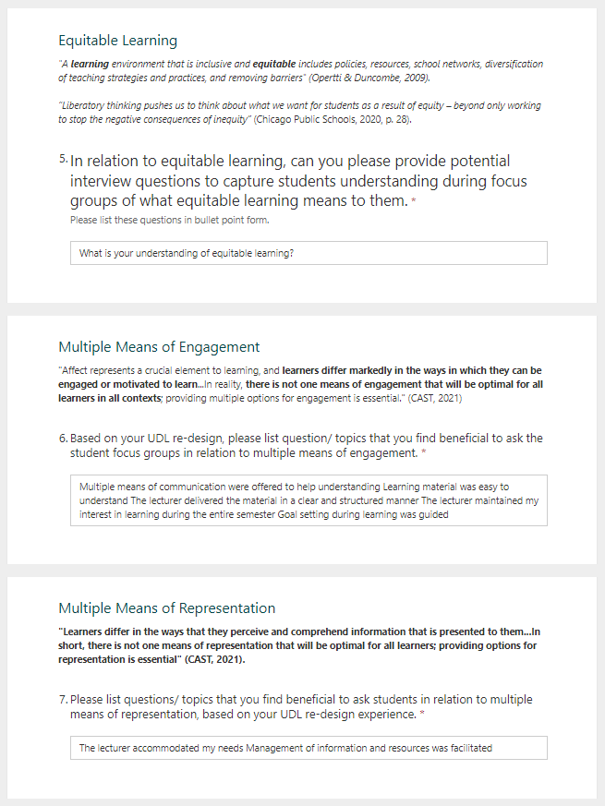

Slide 11
6 Lecturers nominated students. 4 Student Focus Groups were conducted. 12 students participated overall.

Slide 12
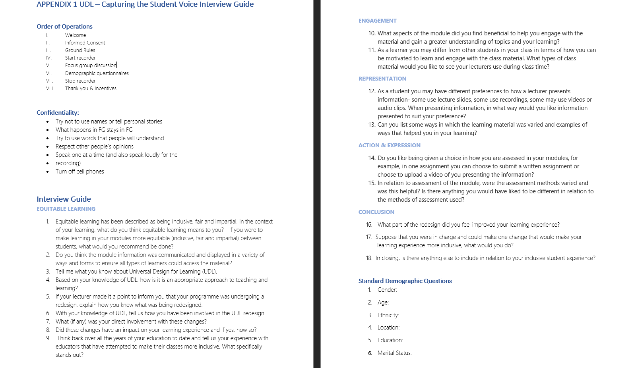

Slide 13
What did we learn?

Slide 14
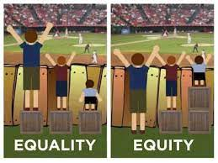
Student Responses
“Equal opportunities in our studies.”
“Image of the playing field with equality boxes.”
“Access to info regardless of background or identity.”
Equitable learning has been described as being inclusive, fair and impartial. In the context of your learning, what does equitable learning means to you?

Slide 15
Student Responses
Do you think the module information was communicated and displayed in a variety of ways and forms to ensure all types of learners could access the material?
“Yes, there was a lot of flexibility in the module.”
“Teams was used and it was very effective. The info and the content was on Moodle and easy to access. Chat function was active and all recordings were available.”

Slide 16
Student Responses
Tell me what you know about Universal Design for Learning (UDL).
“No prior knowledge.”
“Set of principles that give individuals equal opportunities to learn.”
“UDL- for example using (simpler language that students can understand in slides, etc.”

Slide 17
Student Responses
Based on your knowledge of UDL, how is it is an appropriate approach to teaching and learning?
“One change that was really good was how assembly was taught and it was made practical and real life as opposed to Ppt and learning of efficiency on Ppt. We had to do a whole class exercise broken into different days/ classes and in steps, just like assembly, making an assembly line of the learning of it. It stuck with me and I remember all of it as opposed to just memorising it all, I learned it. (AUTHENTIC)It is appropriate because its allowing people to become interactive, instead of essentially copying notes off the white board(INTERACTIVE)”
“Students who do not get their learning needs met may leave their course.”
“Based on how you’ve described it, I can see how my lecturer was varying materials and assessments.”

Slide 18
Student Responses
2 groups aware, 2 unaware
“Lecturer told us they were undertaking a program and making slight changes. We didn’t know it was UDL but we could see the changes and these were good.”
If your lecturer made it a point to inform you that your programme was undergoing a redesign, explain how you knew what was being redesigned.
“Questionnaire for module improvements.”
“Lecturer asked early on if and what were the points we found difficult or uncomfortable in earlier education and how they can improve that. Lecturer was always looking for feedback and making changes to suit this.”
“Based on our preference of learning, the lecturer provided synchronous and asynchronous option of learning.”

Slide 19
Student Responses
What aspects of the module did you find beneficial to help you engage with the material and gain a greater understanding of topics and your learning?
“The lecturer used different programs and we were kept from being bored as she varied the materials. Made it more interesting.”
“Practical exercise, real life experiences in the classroom. (empathising with users and their experience.)”
“Choosing specific piece of assessment.”
“Choice in topic.”
“Less stress in choosing the format.”
“Hit or miss, struggled with the freedom of choice.”
“The Lecturer had us doing tasks we wouldn’t normally like but because of his varied approach, we didn’t even know we were doing research and it made the learning more enjoyable.”

Slide 21
Next Steps: Answering the ‘So what?’

Slide 22
Nothing for us without us…
“Part of the reflection that needs to occur within the UDL movement around power will inevitably lead to a reconsideration of how UDL implementation should occur. The strategic implementation of UDL across campuses has thus far strikingly ignored students as stakeholders. It will be impossible to promote UDL on campuses if a significant effort is not made to involve the student body as stakeholder.
“Much of the literature on the implementation of UDL now focuses on either the buy-in or the resistance of educators, not the perceptions of students” (Izzo, Murray & Novak, 2008; Anstead, 2016; Fovet, 2018).
.
…..

Slide 23
Nothing for us without us…
…..
This involvement could take the shape of workshops and information sessions, but will need to eventually grow in scope; it will require the involvement of student unions, and will eventually need to incorporate full and formal consultation of the student body in order to identify campus-specific variables that need to be taken into account in the way UDL is unrolled.” (Fovet, 2018)
.

Slide 24
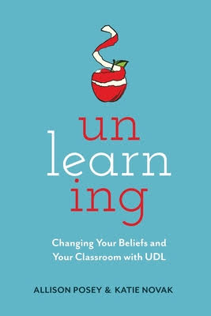
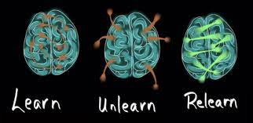
UNLEARNING/Including students in learning about UDL
Understanding variability
Focusing in on goals
Break away from habits that are not serving all learners
Scaffold expert learning
“Implementing UDL also requires us to unlearn many beliefs, assumptions, and teaching practices that no longer work.” - Katie Novak

Slide 25
What next? UDL Student Toolkit, made by, and for students.

Slide 26
HE UDL Centre of Excellence
ATU UDL Student Working Group
Workshops Info Sessions Working with Student Union Digital Badge for students

Slide 27
Resources

Slide 28
Resources

Slide 29
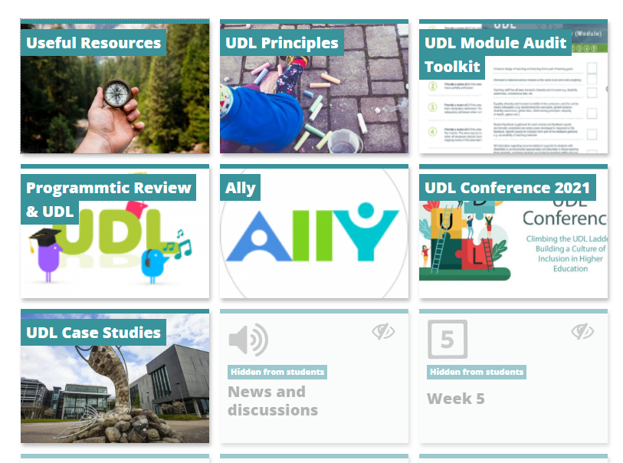
Resources

Slide 30
References AHEAD. 2022. Digital Badge in UDL. [online] Available at: <https://www.ahead.ie/udl-digital-badge> [Accessed 23 May 2022]. Flood, M. (2022) Talking about all thing's inclusion, Podcast Episode 3: Talking ‘Unlearning’ with Allison Posey and Katie Novak. Fovet, F. (2018) Exploring the Student Voice within UDL Work, Ahead Journal -A Review of Inclusive Education & Employment Practices, ISSN 2009-8286Issue 14. Posey, A., & Noval, K. (2020). Unlearning: changing your beliefs and your classroom with UDL.

Slide 31
haran.maureen@itsligo.ie @haran_maureen

